Slide 2
Students will be able to:

Slide 3
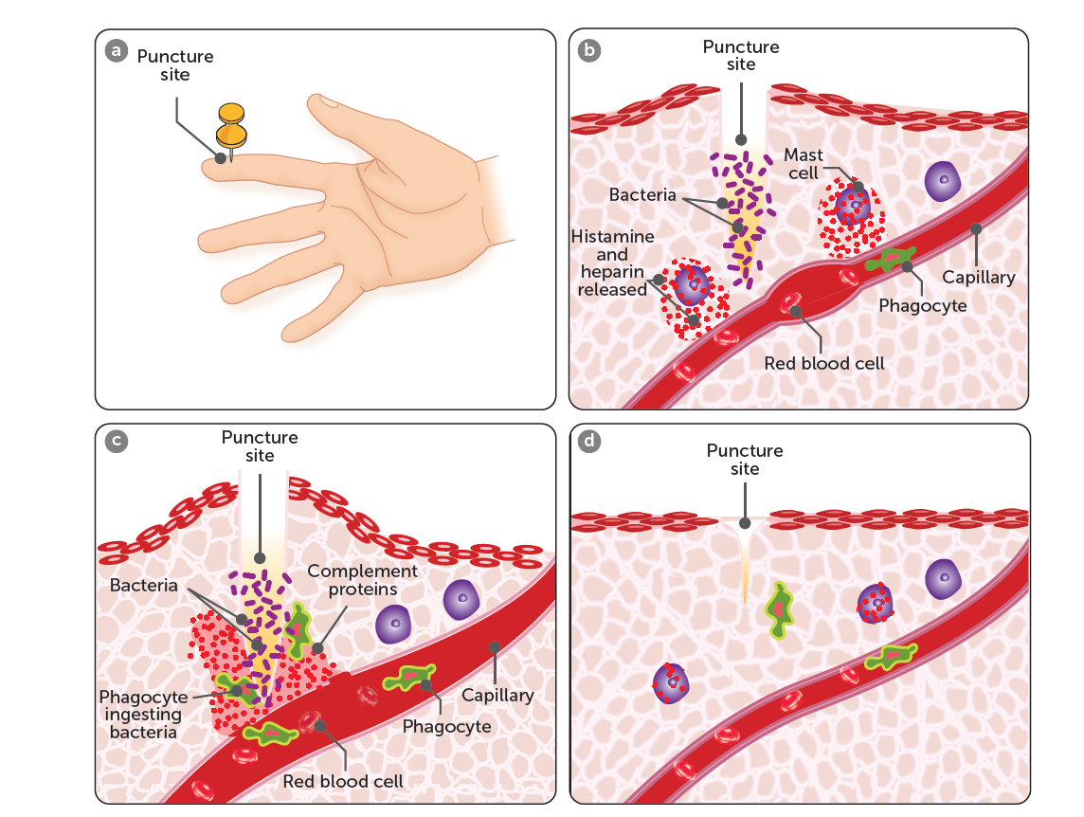
Inflammation
Inflammation involves signs of swelling, pain, redness, and heat. It is made up of seven steps:
1. Mast cells (regulate the immune response) are stimulated by the damaged tissues to secrete substances including complement proteins, histamine and heparin.
Notes:
Teacher Cue – refer to the vocabulary box as you read through and “unpack” the definition provided. Use hand gestures to emphasise the ”2 or more”, “mixed” and “separated” parts of the definition.
Have students complete CFU 1 as a pair-share, then record these definitions & examples as notes (with diagrams) if desired.
CFU 2 – pair-share, then whiteboards for answers – call on non-volunteers.

Slide 4
Inflammation
2. Heat, redness, and swelling are caused by the increased blood flow, and fluid movement from capillaries into the area. This is stimulated by the histamine secreted.
Notes:
CFU – read through the slide, have students look closely at the diagram, then allow think time, before asking them to explain it to their partner using the key terms pure substance and mixture. Call on non-volunteers and provide feedback, encouraging detailed responses in full sentence form.

Slide 5
Inflammation
3. Heparin is an anticoagulant (i.e. it prevents the blood from clotting). A fluid clot forms of injury to prevent entry of pathogens.
Notes:
CFU – read through the slide, have students look closely at the diagram, then allow think time, before asking them to explain it to their partner using the key terms pure substance and mixture. Call on non-volunteers and provide feedback, encouraging detailed responses in full sentence form.

Slide 6
Inflammation
4. The complement proteins attract phagocytes which consume any cell debris and micro-organisms.
Notes:
CFU – read through the slide, have students look closely at the diagram, then allow think time, before asking them to explain it to their partner using the key terms pure substance and mixture. Call on non-volunteers and provide feedback, encouraging detailed responses in full sentence form.

Slide 7
Inflammation
5. The tissue damage stimulates nociceptors causing pain.
Notes:
CFU – read through the slide, have students look closely at the diagram, then allow think time, before asking them to explain it to their partner using the key terms pure substance and mixture. Call on non-volunteers and provide feedback, encouraging detailed responses in full sentence form.

Slide 8
Inflammation
6. Pus is formed from dead phagocytes and their contents, and tissue fluid.
Notes:
CFU – read through the slide, have students look closely at the diagram, then allow think time, before asking them to explain it to their partner using the key terms pure substance and mixture. Call on non-volunteers and provide feedback, encouraging detailed responses in full sentence form.

Slide 9
Inflammation
7. Mitosis produces new cells, repairing the damaged tissues.
Notes:
CFU – read through the slide, have students look closely at the diagram, then allow think time, before asking them to explain it to their partner using the key terms pure substance and mixture. Call on non-volunteers and provide feedback, encouraging detailed responses in full sentence form.

Slide 10
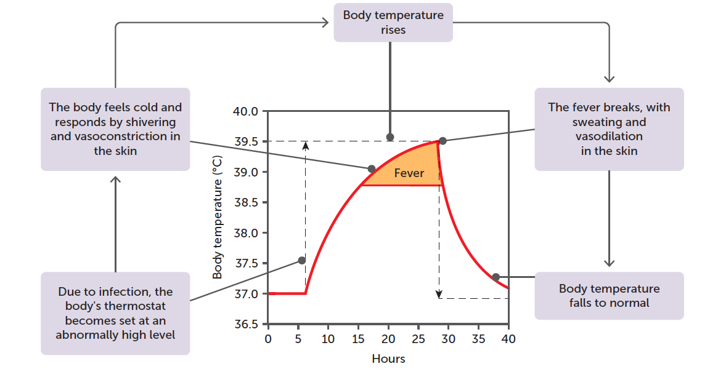
Fever
Infection can also cause fever, which is an elevation of the body temperature. It is believed that this is caused by substances called pyrogens, which are secreted by white blood cells during the inflammatory response, and act on the hypothalamus.
Notes:
CFU – read through the slide, have students look closely at the diagram, then allow think time, before asking them to explain it to their partner using the key terms pure substance and mixture. Call on non-volunteers and provide feedback, encouraging detailed responses in full sentence form.

Slide 11
Fever
The hypothalamus then raises the temperature level of the body (homeostatic mechanisms are still in place, but they work to bring the body temperature to one that is higher than the normal 37°C).
When the fever breaks, homeostatic mechanisms work to bring the body temperature down by reducing the amount of heat produced and promoting heat loss.
Fever is thought to inhibit growth of micro-organisms, and accelerate the rate of chemical reactions, hence accelerating the healing process.

Slide 12
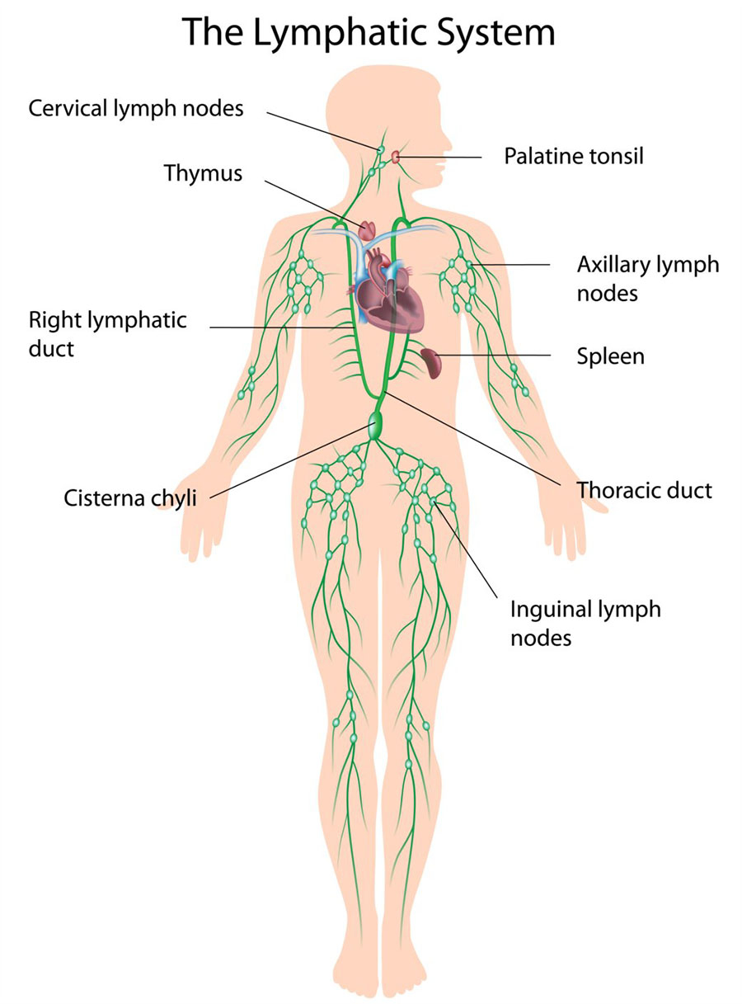
Lymphatic System
Also involved in non-specific internal defence is the lymphatic system. The lymph nodes that occur along the length of lymph vessels consist of masses of lymphatic tissue, which also contains a network of fibres.
When the lymph (fluid pushed out of the circulatory system) moves through the lymph nodes as it travels through a vessel, and foreign particles become trapped in the fibres, where they can then be digested by the enzymatic action of phagocytes.

